Slide 1
Windows Kernel Internals
Virtual Memory Manager
*David B. Probert, Ph.D.
Windows Kernel Development
Microsoft Corporation

Slide 2
Virtual Memory Manager
Features
Provides 4 GB flat virtual address space (IA32)
Manages process address space
Handles pagefaults
Manages process working sets
Manages physical memory
Provides memory-mapped files
Supports shared memory and copy-on-write
Facilities for I/O subsystem and device drivers
Supports file system cache manager

Slide 3
Virtual Memory Manager
Features
Provide session space for Win32 GUI applications
Address Windowing Extensions (physical overlays)
Address space cloning (posix/fork() support)
Kernel-mode memory heap allocator (pool)
  Paged Pool, Non-paged pool, Special pool/verifier

Slide 4
Virtual Memory Manager
Windows Server 2003 enhancements
Support for Large (4MB) page mappings
Improved TB performance, remove ContextSwap lock
On-demand proto-PTE allocation for mapped files
Other performance & scalability improvements
Support for IA64 and Amd64 processors

Slide 5
Virtual Memory Manager
NT Internal APIs
NtCreatePagingFile
NtAllocateVirtualMemory (Proc, Addr, Size, Type, Prot)
  Process: handle to a process
  Protection: NOACCESS, EXECUTE, READONLY, READWRITE, NOCACHE
  Flags: COMMIT, RESERVE, PHYSICAL, TOP_DOWN, RESET, LARGE_PAGES, WRITE_WATCH
NtFreeVirtualMemory(Process, Address, Size, FreeType)
  FreeType: DECOMMIT or RELEASE
NtQueryVirtualMemory
NtProtectVirtualMemory

Slide 6
Virtual Memory Manager
NT Internal APIs
Pagefault
NtLockVirtualMemory, NtUnlockVirtualMemory
  locks a region of pages within the working set list
  requires PROCESS_VM_OPERATION on target process and SeLockMemoryPrivilege
NtReadVirtualMemory, NtWriteVirtualMemory (
        Proc, Addr, Buffer, Size)
NtFlushVirtualMemory

Slide 7
Virtual Memory Manager
NT Internal APIs
NtCreateSection
  creates a section but does not map it
NtOpenSection
  opens an existing section
NtQuerySection
  query attributes for section
NtExtendSection
NtMapViewOfSection (Sect, Proc, Addr, Size, …)
NtUnmapViewOfSection

Slide 8
Virtual Memory Manager
NT Internal APIs
APIs to support AWE (Address Windowing Extensions)
  Private memory only
  Map only in current process
  Requires LOCK_VM privilege
NtAllocateUserPhysicalPages (Proc, NPages, &PFNs[])
NtMapUserPhysicalPages (Addr, NPages, PFNs[])
NtMapUserPhysicalPagesScatter
NtFreeUserPhysicalPages (Proc, &NPages, PFNs[])
NtResetWriteWatch
NtGetWriteWatch
  Read out dirty bits for a section of memory since last reset

Slide 9
Allocating kernel memory (pool)
Tightest x86 system resource is KVA
    Kernel Virtual Address space
Pool allocates in small chunks:
    < 4KB: 8B granulariy
    >= 4KB: page granularity
Paged and Non-paged pool
    Paged pool backed by pagefile
Special pool used to find corruptors
Lots of support for debugging/diagnosis

Slide 10
80000000
System code, initial non-paged pool
A0000000
Session space (win32k.sys)
A4000000
Sysptes overflow, cache overflow
C0000000
Page directory self-map and page tables
C0400000
x86
Hyperspace (e.g. working set list)
C0800000
Unused – no access
C0C00000
System working set list
C1000000
System cache
E1000000
Paged pool
E8000000
Reusable system VA (sysptes)
Non-paged pool expansion
FFBE0000
Crash dump information
FFC00000
HAL usage

Slide 11
Looking at a pool page
kd> !pool e1001050
e1001000 size: 40 prev size: 0 (Allocated) MmDT
e1001040 size: 10 prev size: 40 (Free) Mm
*e1001050 size: 10 prev size: 10 (Allocated) *ObDi
e1001060 size: 10 prev size: 10 (Allocated) ObDi
e1001070 size: 10 prev size: 10 (Allocated) Symt
e1001080 size: 40 prev size: 10 (Allocated) ObDm
e10010c0 size: 10 prev size: 40 (Allocated) ObDi
MmDT - nt!mm - Mm debug
Mm - nt!mm - general Mm Allocations
ObDi - nt!ob - object directory
Symt - <unknown> - Symbolic link target strings
ObDm - nt!ob - object device map

Slide 12
Layout of pool headers
31 23 16 15 7 0
+----------------------------------------------------------+
| Current Size | PoolType+1 | Pool Index |Previous Size |
+----------------------------------------------------------+
| ProcessCharged (NULL if not allocated with quota) |
+----------------------------------------------------------+
| Zero or more longwords of pad such that the pool header |
| is on a cache line boundary and the pool body is also |
| on a cache line boundary. |
+----------------------------------------------------------+
PoolBody:
+----------------------------------------------------------+
| Used by allocator, or when free FLINK into sized list |
+----------------------------------------------------------+
| Used by allocator, or when free BLINK into sized list |
+----------------------------------------------------------+
... rest of pool block...
Size fields of pool headers expressed in units of smallest pool block size.

Slide 13
Managing memory for I/O
Memory Descriptor Lists (MDL)
Describes pages in a buffer in terms of physical pages
  typedef struct _MDL {
  struct _MDL *Next;
  CSHORT Size;
  CSHORT MdlFlags;
  struct _EPROCESS *Process;
  PVOID MappedSystemVa;
  PVOID StartVa;
  ULONG ByteCount;
  ULONG ByteOffset;
  } MDL, *PMDL;

Slide 14
MDL flags
MDL_MAPPED_TO_SYSTEM_VA 0x0001
MDL_PAGES_LOCKED 0x0002
MDL_SOURCE_IS_NONPAGED_POOL 0x0004
MDL_ALLOCATED_FIXED_SIZE 0x0008
MDL_PARTIAL 0x0010
MDL_PARTIAL_HAS_BEEN_MAPPED 0x0020
MDL_IO_PAGE_READ 0x0040
MDL_WRITE_OPERATION 0x0080
MDL_PARENT_MAPPED_SYSTEM_VA 0x0100
MDL_FREE_EXTRA_PTES 0x0200
MDL_DESCRIBES_AWE 0x0400
MDL_IO_SPACE 0x0800
MDL_NETWORK_HEADER 0x1000
MDL_MAPPING_CAN_FAIL 0x2000
MDL_ALLOCATED_MUST_SUCCEED 0x4000

Slide 15
80000000
System code, initial non-paged pool
KVA
A0000000
Session space (win32k.sys)
A4000000
Sysptes overflow, cache overflow
C0000000
Page directory self-map and page tables
C0400000
Hyperspace (e.g. working set list)
C0800000
Unused – no access
x86
C0C00000
System working set list
C1000000
System cache
E1000000
Paged pool
E8000000
Reusable system VA (sysptes)
Non-paged pool expansion
FFBE0000
Crash dump information
FFC00000
HAL usage

Slide 16
Sysptes
Used to manage random use of kernel virtual memory, e.g. by device drivers.
Kernel implements functions like:
MiReserveSystemPtes (n, type)
MiMapLockedPagesInUserSpace
(mdl, virtaddr, cachetype,basevirtaddr)
Often a critical resource!

Slide 17
Process/Thread structure
Any Handle
Table
Object
Manager
Process
Object
Thread
Thread
Files
Process’
Handle Table
Virtual
Address
Descriptors
Thread
Events
Thread
Devices
Thread
Drivers
Thread

Slide 18
Process
Container for an address space and threads
Associated User-mode Process Environment Block (PEB)
Primary Access Token
Quota, Debug port, Handle Table etc
Unique process ID
Queued to the Job, global process list and Session list
MM structures like the WorkingSet, VAD tree, AWE etc

Slide 19
Thread
Fundamental schedulable entity in the system
Represented by ETHREAD that includes a KTHREAD
Queued to the process (both E and K thread)
IRP list
Impersonation Access Token
Unique thread ID
Associated User-mode Thread Environment Block (TEB)
User-mode stack
Kernel-mode stack
Processor Control Block (in KTHREAD) for cpu state when not running

Slide 20
Virtual Address Translation
CR3
PD
PT
page
DATA
1024 PDEs
1024 PTEs
4096 bytes
0000 0000 0000 0000 0000 0000 0000 0000

Slide 21
Windows Virtual Memory Model
User-mode (2GB or 3GB with boot option)
Code/data from executables (e.g. .exe, .dll)
Thread/process environment blocks (TEB/PEB)
User-mode stacks, heaps
Kernel-mode (2GB or 1GB)
Kernel, hal, drivers
Kernel-mode stacks, heap (i.e. pool), pagetables
File-cache (cache and pool small if 1GB)
Terminal-server session space (for Win32k)
Kernel data structures and objects

Slide 22
Physical Memory Model (IA32)
Limit is 4GB (or 64GB w/ PAE support)
PAE support requires 64-bit PTE entries
  Separate kernel needed as all MM data recompiled
Thread/process environment blocks (TEB/PEB)
User-mode stacks, heaps
Large server applications can use AWE
Address Window Extension
Processes allocate contiguous physical memory
Memory Manager allows map/unmap via AWE APIs
Large (4MB) pages supported for TLB efficiency
64b Windows makes virtual/physical limits moot

Slide 23
80000000
System code, initial non-paged pool
KVA
A0000000
Session space (win32k.sys)
A4000000
Sysptes overflow, cache overflow
C0000000
Page directory self-map and page tables
C0400000
Hyperspace (e.g. working set list)
C0800000
Unused – no access
C0C00000
System working set list
x86
C1000000
System cache
E1000000
Paged pool
E8000000
Reusable system VA (sysptes)
Non-paged pool expansion
FFBE0000
Crash dump information
FFC00000
HAL usage

Slide 24
Self-mapping page tables
Normal Virtual Address Translation
CR3
PD
PT
page
DATA
1024 PDEs
1024 PTEs
4096 bytes
0000 0000 0000 0000 0000 0000 0000 0000

Slide 25
Self-mapping page tables
Virtual Access to PageDirectory[0x300]
CR3
CR3
PD
PD
Phys: PD[0xc0300000>>22] = PD
Virt: *((0xc0300c00) == PD
0x300
PTE
0000 0000 0000 0000 0000 0000 0000 0000
1100 0000 0011 0000 0000 1100 0000 0000

Slide 26
Self-mapping page tables
Virtual Access to PTE for va 0xe4321000
CR3
CR3
PD
PT
PD
GetPteAddress: 0xe4321000 => 0xc0390c84
0x300
0x321
PTE
0x390
0000 0000 0000 0000 0000 0000 0000 0000
1100 0000 0011 1001 0000 1100 1000 0100

Slide 27
Self-mapping page tables
Page Table Entries (PTEs) and Page Directory Entries (PDEs) contain Physical Frame Numbers (PFNs)
  But Kernel runs with Virtual Addresses
To access PDE/PTE from kernel use the self-map for the current process:
  PageDirectory[0x300] uses PageDirectory as PageTable
  GetPdeAddress(va): 0xc0300000[va>>20]
  GetPteAddress(va): 0xc0000000[va>>10]
PDE/PTE formats are compatible!
Access another process VA via thread ‘attach’

Slide 28
Valid x86 Hardware PTEs
Reserved
Global
Dirty
Accessed
Cache disabled
Write through
Owner
Write
Pageframe
R
R
R
G
R
D
A
Cd
Wt
O
W
1
31
12
11
10
9
8
7
6
5
4
3
2
1
0

Slide 29
x86 Invalid PTEs
Transition
Page file
Prototype
Page file offset
0
Protection
PFN
0
31
12
11
10
9
5
4
1
0
Transition
Transition
Prototype
Page file offset
1
Protection
HW ctrl
0
31
12
11
10
9
5
4
1
0
Cache disable
Write through
Owner
Write

Slide 30
x86 Invalid PTEs
Demand zero: Page file PTE with zero offset and PFN
Unknown: PTE is completely zero or Page Table doesn’t exist yet. Examine VADs.
Pointer to Prototype PTE
pPte bits 7-27
pPte bits 0-6
0
31
12
11
10
9
8
7
5
4
1
0

Slide 31
Prototype PTEs
Kept in array in the segment structure associated with section objects
Six PTE states:
  Active/valid
  Transition
  Modified-no-write
  Demand zero
  Page file
  Mapped file

Slide 32
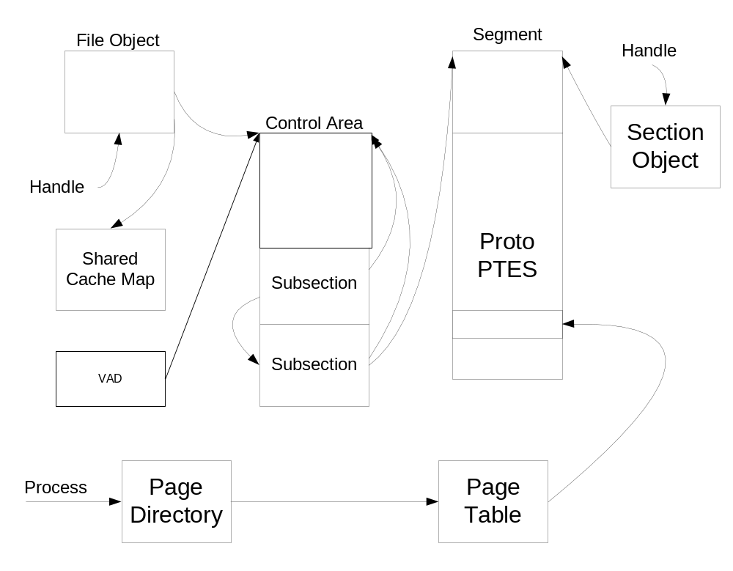
Shared Memory Data Structures

Slide 33
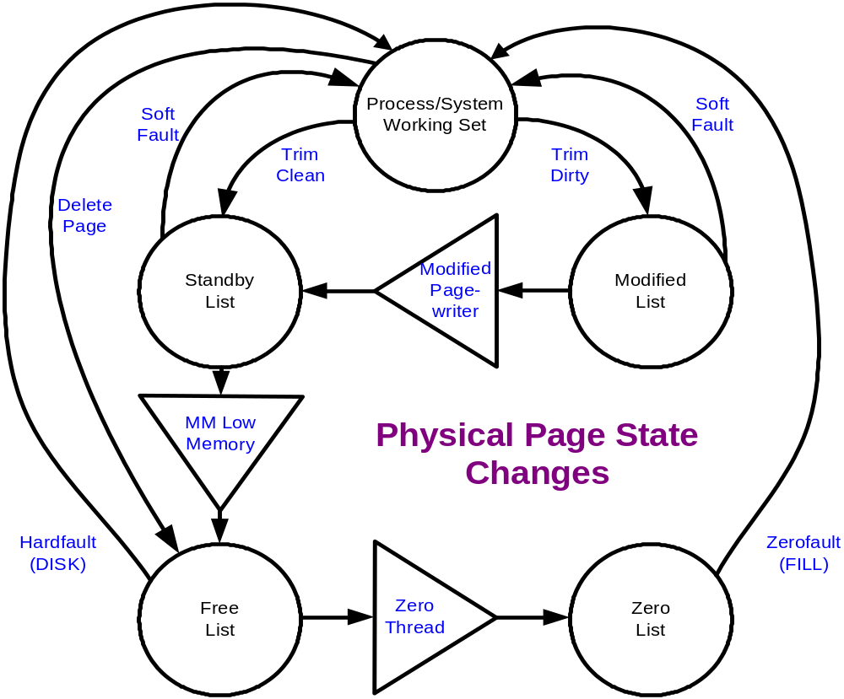
Physical Memory Management

Slide 34
Paging Overview
Working Sets: list of valid pages for each process (and the kernel)
Pages ‘trimmed’ from working set on lists
  Standby list: pages backed by disk
  Modified list: dirty pages to push to disk
  Free list: pages not associated with disk
  Zero list: supply of demand-zero pages
Modify/standby pages can be faulted back into a working set w/o disk activity (soft fault)
Background system threads trim working sets, write modified pages and produce zero pages based on memory state and config parameters

Slide 35
80000000
System code, initial non-paged pool
KVA
A0000000
Session space (win32k.sys)
A4000000
Sysptes overflow, cache overflow
x86
C0000000
Page directory self-map and page tables
C0400000
Hyperspace (e.g. working set list)
C0800000
Unused – no access
C0C00000
System working set list
C1000000
System cache
E1000000
Paged pool
E8000000
Reusable system VA (sysptes)
Non-paged pool expansion
FFBE0000
Crash dump information
FFC00000
HAL usage

Slide 36
Managing Working Sets
Aging pages: Increment age counts for pages which haven't been accessed
Estimate unused pages: count in working set and keep a global count of estimate
When getting tight on memory: replace rather than add pages when a fault occurs in a working set with significant unused pages
When memory is tight: reduce (trim) working sets which are above their maximum
Balance Set Manager: periodically runs Working Set Trimmer, also swaps out kernel stacks of long-waiting threads

Slide 37
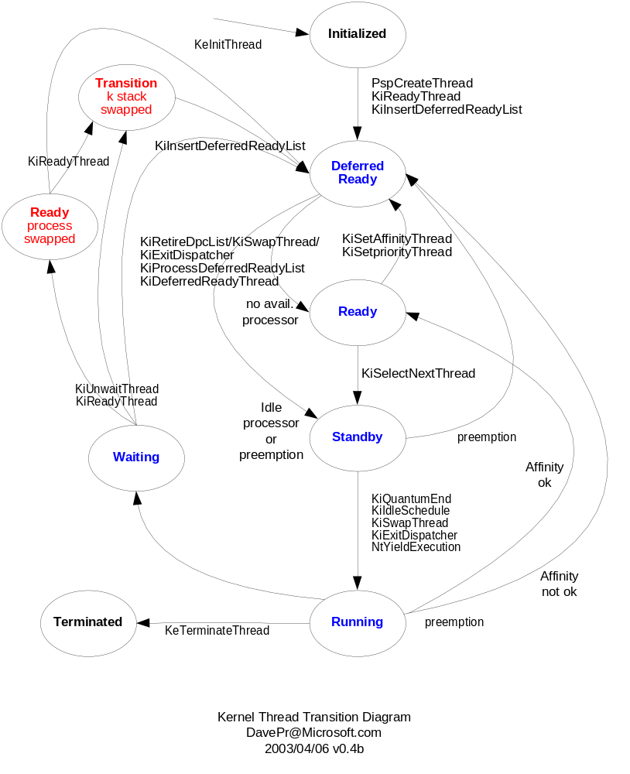
Thread scheduling states

Slide 38
Thread scheduling states
Main quasi-states:
  Ready – able to run
  Running – current thread on a processor
  Waiting – waiting an event
For scalability Ready is three real states:
  DeferredReady – queued on any processor
  Standby – will be imminently start Running
  Ready – queue on target processor by priority
Goal is granular locking of thread priority queues
Red states related to swapped stacks and processes

Slide 39
80000000
System code, initial non-paged pool
KVA
A0000000
Session space (win32k.sys)
A4000000
Sysptes overflow, cache overflow
C0000000
Page directory self-map and page tables
C0400000
Hyperspace (e.g. working set list)
x86
C0800000
Unused – no access
C0C00000
System working set list
C1000000
System cache
E1000000
Paged pool
E8000000
Reusable system VA (sysptes)
Non-paged pool expansion
FFBE0000
Crash dump information
FFC00000
HAL usage

Slide 40
File Cache Manager
Kernel APIs & worker threads that interface the file systems to memory manager
  File-based, not block-based
  Access methods for pages of opened files
  Automatic asynch read ahead
  Automatic asynch write behind (lazy write)
  Supports “Fast I/O” – IRP bypass
  Works with file system metadata (pseudo files)

Slide 41
Cache Manager Block Diagram
Fast IO Read/Write
Cached IO
IRP-based Read/Write
Cache Manager
Filesystem
Cache Access, Flush, Purge
Page Fault
Noncached IO
Memory Manager
Storage Drivers
Disk

Slide 42
Cache Manager and MM
The Cache Manager sits between the file systems and the memory manager
  Mapped stream model integrated with memory management
  Cached streams are mapped with fixed-size views (256KB)
  Pages are faulted into memory via MM
  Pages may be modified in memory and written back
  MM manages global memory policy

Slide 43
Pagefault Cluster Hints
Taking a pagefault can result in Mm opportunistically bringing surrounding pages in (up 7/15 depending)
Since Cc takes pagefaults on streams, but knows a lot about which pages are useful, Mm provides a hinting mechanism in the TLS
  MmSetPageFaultReadAhead()
Not exposed to usermode …

Slide 44
Cache Manager Data Structures
Kernel
FS Handle Context (2)
File Object
Filesystem File Context
Handle
Private Cache Map (Cc)
Data Section (Mm)
Image Section (Mm)
Section Object Pointers
Shared Cache Map (Cc)
File Object == Handle (U or K), not one per file
Section Object Pointers and FS File Context are the same for all file objects for the same stream

Slide 45
Cache View Management
A Shared Cache Map has an array of View Access Control Block (VACB) pointers which record the base cache address of each view
  promoted to a sparse form for files > 32MB
Access interfaces map File+FileOffset to a cache address
Taking a view miss results in a new mapping, possibly unmapping an unreferenced view in another file (views are recycled LRU)
Since a view is fixed size, mapping across a view is impossible – Cc returns one address
Fixed size means no fragmentation …

Slide 46
Cache View Mapping
File Offfset
0-256KB
256KB-512KB
512KB-768KB
c1000000
<NULL>
cf0c0000
VACB Array

Slide 47
Cache Manager Readahead
CcScheduleReadAhead detects patterns on a handle and schedules readahead into the next suspected ranges
  Regular motion, backwards and forwards, with gaps
  Private Cache Map contains the per-handle info
  Called by CcCopyRead and CcMdlRead
Readahead granularity (64KB) controls the scheduling trigger points and length
  Small IOs – don’t want readahead every 4KB
  Large IOs – ya get what ya need (up to 8MB, thanks to Jim Gray)
CcPerformReadAhead maps and touch-faults pages in a Cc worker thread, will use the new Mm prefetch APIs in a future release

Slide 48
Cache Manager Unmap Behind
Views are managed on demand (by misses)
On view miss, Cc will unmap two views behind the current (missed) view before mapping
Unmapped valid pages go to the standby list in LRU order and can be soft-faulted
Unmap behind logic is default due to large file read/write operations causing huge swings in working set.
Mm’s working set trim falls down at the speed a disk can produce pages, Cc must help.

Slide 49
Cache Hints
Cache hints affect both read ahead and unmap behind
Two flags specifiable at Win32 CreateFile()
  FILE_FLAG_SEQUENTIAL_SCAN
    doubles readahead unit on handle, unmaps to the front of the standby list (MRU order) if all handles are SEQUENTIAL
  FILE_FLAG_RANDOM_ACCESS
    turns off readahead on handle, turns off unmap behind logic if any handle is RANDOM
Unfortunately, there is no way to split the effect

Slide 50
Cache Write Throttling
Avoids out of memory problems by delaying writes to the cache
  Filling memory faster than writeback speed is not useful, we may as well run into it sooner
Throttle limit is twofold
  CcDirtyPageThreshold – dynamic, but ~1500 on all current machines (small, but see above)
  MmAvailablePages & pagefile page backlog
CcCanIWrite sees if write is ok, optionally blocking, also serving as the restart test
CcDeferWrite sets up for callback when write should be allowed (async case)
!defwrites debugger extension triages and shows the state of the throttle

Slide 51
Writing Cached Data
There are three basic sets of threads involved, only one of which is Cc’s
  Mm’s modified page writer
    the paging file
  Mm’s mapped page writer
    almost anything else
  Cc’s lazy writer pool
    executing in the kernel critical work queue
    writes data produced through Cc interfaces

Slide 52
The Lazy Writer
Name is misleading, its really delayed
All files with dirty data have been queued onto CcDirtySharedCacheMapList
Work queueing – CcLazyWriteScan()
  Once per second, queues work to arrive at writing 1/8th of dirty data given current dirty and production rates
  Fairness considerations are interesting
CcLazyWriterCursor rotated around the list, pointing at the next file to operate on (fairness)
  16th pass rule for user and metadata streams
Work issuing – CcWriteBehind()
  Uses a special mode of CcFlushCache() which flushes front to back (HotSpots – fairness again)
Notes:
Tries to only write a given metadata stream every 16th pass to try to batch up rapid changes (but gives up if there is more than 4 * MM maximum write cluster’s worth)
Cursor moves forward on every metadata write, but if a user file continues to donate pages it will write it up to 16 passes in a row to avoid possible seeks

Slide 53
Valid Data Length (VDL) Calls
Cache Manager knows highest offset successfully written to disk – via the lazy writer
File system is informed by special FileEndOfFileInformation call after each write which extends/maintains VDL
FS which persist VDL to disk (NTFS) push that down here
FS use it as a hint to update directory entries (recall Fast IO extension, one among several)
CcFlushCache() flushing front to back is important so we move VDL on disk as soon as possible.

Slide 54
Filesystem Cache Interfaces
Two distinct access interfaces
  Map – given File+FileOffset, return a cache address
  Pin – same, but acquires synchronization – this is a range lock on the stream
    Lazy writer acquires synchronization, allowing it to serialize metadata production with metadata writing
Pinning also allows setting of a log sequence number (LSN) on the update, for transactional FS
  FS receives an LSN callback from the lazy writer prior to range flush

Slide 55
Summary
Manages physical memory and pagefiles
Manages user/kernel virtual space
Working-set based management
Provides shared-memory
Supports physical I/O
Address Windowing Extensions for large memory
Provides session-memory for Win32k GUI processes
File cache based on shared sections
Single implementation spans multiple architectures

Slide 56
Discussion

